Slide 1
SCYM questions

Slide 2
Original SCYM (Lobell et al, 2015)
Our SCYM
Hypothetical soil, climate, management
Actual soil (IGBP-DIS), climate (CLIMA), management (double crop maps)
Why not just apply crop model to all soy pixels after we’ve calibrated model parameters?
Crop sims
APSIM
INLAND
Calibrate model parameters using yield data
Daily LAI, seasonal yield
Daily LAI, seasonal yield
Pseudo-obs
Vegetation indeces (pseudo RM_{d})
Vegetation indeces (pseudo RM_{d} or actual RM_{d}?)
Bias corrected sim yield
Regression
Sim yield =
fcn(hypothetical weather, pseudo RM_{d})
Sim yield =
fcn(actual weather, pseudo RM_{d} or actual RM_{d}?)
Yield estimation
Apply regression eqn to actual RS data and actual weather
Apply regression eqn to pseudo RS data from phenology model and simulated weather

Slide 3
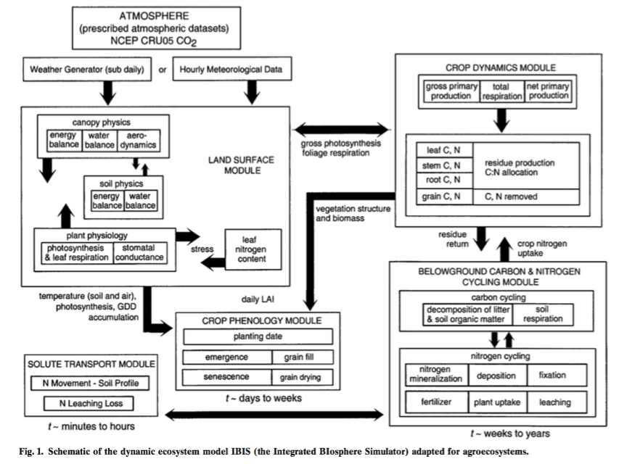
(Kucharik and Brye, 2003) IBIS crop model

Slide 4
Jake, Gabriel, Avery meeting
Crop background
What is the crop sim (is it INLAND)? Where can I find documentation?
Can I just look at IBIS documentation to get background – are the two models similar enough?
What is the advantage of this model compared to others?
Agro-IBIS is the agri module in INLAND, but we are using the entire INLAND model? Why do we need the entire model if all we care about is the agriculture part?
Is the entire model in GEE or somewhere else? Is it really written in FORTRAN? Will we be running the model in GEE or offline?
Data needed
We’ll use CLIMA weather data as input?
What agricultural management practices are needed/supported?
What do you use for soil types when you run the model? – is it the IGBP-DIS dataset?
General theory…
What do we gain by doing the regression: yield <- (“RS observations” from phenology model, weather)? Especially if we’re calibrating model parameters according to yield data?

Slide 5
Why not the following method?
Step 1. Regression to get ET -> yield relationship
ET data from CLIMA
Relationship between ET and yield
Like in (Purcell et al, 2007)
Yield data
Step 2. Relate LU -> yield through ET
Simulated weather for each LU %
ET from Penman Monteith
Yield

Slide 6
Regression equations for precip, max/min T, radiation, wind, humidity per LU % class
Code and data needed to run regression equations
Map of LU % classes across Brazil
Overlay 500m soymap and LU % classes, mask out coasts, urban areas, large water bodies for a final analysis map
Weather simulations
5000ish year simulations of max/min T, P, radiation, wind, humidity, CO2 (?)
Code to simulate weather from statistics
Soybean maturity class maps
Crop sim parameters: GDD of crops, management info, crop density, sow dates, soil, max LAI
INLAND (daily yield, LAI)
Decide on remote sensing “pseudo observation” and its equation
Calculate pseudo remote sensing observations for all crop sim results
Pseudo-observations
Gridded monthly precip, radiation, temp, daytime vapor P deficit information
Landsat (to calculate RS pseudo observations)
Decide on “observation dates” to put in regression
Get real yield data, then calibrate with real yield data
From Dave
From Eric
From Avery/Jake/Gabriel
Regression calibrations
Yield pdfs (or statistics) for each maturity class and LU % class on a map

Slide 7
IBIS/INLAND crop model notes
(Kucharik and Twine, 2007)
Agro-IBIS does have phenology
They reference Kucharik and Brye, 2003, for Agro-IBIS description (agroecosystem model)
Model components: 11 soil layers to 2.5m depth, which are parametrized with one of eleven soil textural categories and corresponding physical attributes. The model has parameters for stomatal conductance, canopy exchange processes. It also simulates crop growth transitions through phenological stages (emergence, grain fill, etc) using accumulated GDD.
To drive Agro-IBIS simulations, used air temperature, precipitation, downward longwave and shortwave radiation, wind speed, relative humidity, soil texture, atmsopheric CO2, atmospheric pressure (which is estimated using elevation and air T assuming a lapse rate) – so therefore also need elevation dataset. Do not need planting density
(Foley et al, 1996)
This paper has very specific details on the model
We need soil information down to 2m.

Slide 8

Questions
Do I need to overlay the soymap on top of the %forest, %nonforest information? Or is someone else already working on it?
What do I need to do to prep for running the crop model across Brazil? (in terms of coding on GEE, dataset gathering)
How would we calibrate SCYM based on soybean yield data? Will calibration happen at the crop sim step or at the “regression calibration” step? How to bias correct?
How are we going to generate simulated temperature, rainfall, solar radiation, specific humidity if they are correlated? In addition to regressions for T and precip, will we also have regressions for solar radiation and humidity?
In order to do the “regression calibration” step for SCYM, we need to simultaneously know the yield (from crop sim) and weather (solar radiation, vapor pressure, temperature) and remotely sensed data. How can we do this regression using real RS data when our weather is simulated?

